Slide 1
Presented by;
Ammad.M.faisal
TOPIC;
SELF PRESENTATION

Slide 2


Slide 3

INTRODUCTION
HELLO EVERYONE
MY NAME IS AMMAD M,FAISAL I AM FROM KARACHI AND CURRENT STUDY IN CLASS 10TH GRADE IN COMPUTER SCIENCE.TODAY I AM DISCUSS ABOUT MY SELF INTRODUCTION.

Slide 4

Personality Traits
My personality traits are that I am friendly, honest, and hard worker. I like to help others and learn new things every day. Some times I am shy, but I try to speak with confidence. I believe good traits make a person successful.

Slide 5
HOBBIES AND INTERESTS
My hobbies are reading books, playing cricket. I also enjoy listening to music in my free time. One of my special interests is learning about computers and new technology. These hobbies and interests make me happy and help me learn new skills.

Slide 6

PERSONALITY ACHIEVEMENTS
I got positions in my class from grade “1 to grade 6” .I always take part in school competitions and sometimes win prize. I have improved my English speaking and reading skill. I represented my class in debates and quiz program. I learned how to use computers and make presentations. I try to help my classmates in studies, which is also my small achievement .

Slide 7
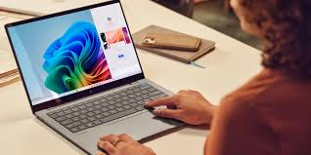
SKILLS LEARNED IN THIS COURSE
In this course, I have learned important computer skill. I can use MS Office (Word, Excel, PowerPoint, Access).I also learned the basics of Networking like LAN and WAN. In addition, I improved my typing speed and learned to make simple presentation. These skills will help me in my studies and future career.

Slide 8
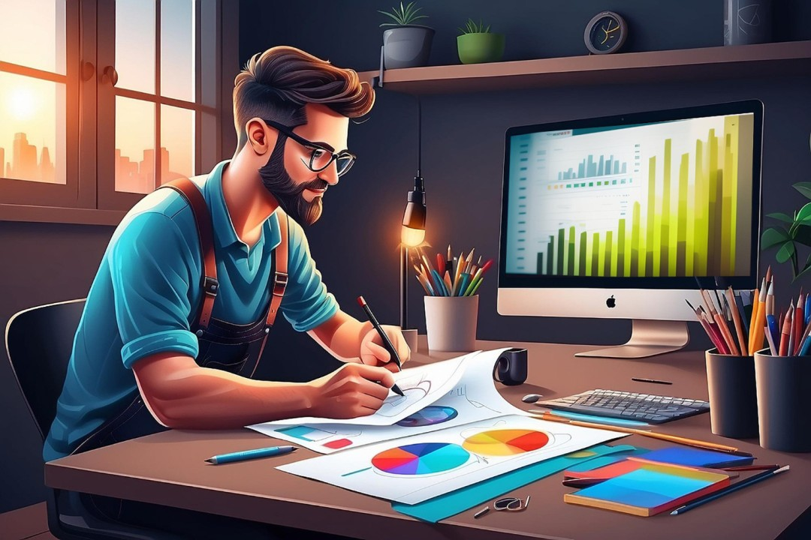
FAVORITE TOPIC;
My favorite topic is Graphic Designer. A graphic designer is a creative person who makes designs with the help of a computer. They create logos, posters, advertisements, and social media posts. Graphic design is a way of communicating ideas through colors, shapes, and pictures.

Slide 9
STRENGHTS AND WEAKNESS
STRNGHTS;
My strengths are that I am hardworking, friendly, and always ready to learn new things. I try to help my classmates and complete my homework on time.
WEAKNESS;
My weaknesses are that sometimes I feel shy to speak in front of the class.
I also need to improve my time management and handwriting.

Slide 10

FUTURE GOALS;
My future goal is to become a good computer expert. I want to learn programming and create useful software In the future, I also want to work in the field of Artificial Intelligence I will try to use my computer knowledge to help people and solve real problems My dream is to make my parents proud and build a successful career in technology.

Slide 11
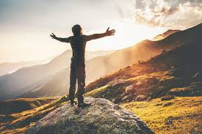
INSPIRATION;
My inspiration is my teacher.He/She always guides me to work hard and never give up.I learn discipline, honesty, and kindness from my teacher.This inspires me to study well and achieve my goals.I believe good teachers are a light for students.

Slide 12

closing
Thank you all for listening to my presentation. I hope you enjoyed and learned something about me. I will keep working hard to improve myself. Once again, thank you for your time and attention.

Slide 13


